Slide 1

Population Stratification 2016 Summer Workshop CEDUA El Colegio de Mexico, A. C.
Ben Domingue

Slide 2
Introduction

Slide 3
Today’s Goals

Slide 4
Schedule
LECTURE | HANDS-ON
Genome-wide data | Linux tools Starting with plink
Population stratification | More plink! Hapmap
Heritability | GCTA Other measures of relatedness
Polygenic Scores | Constructing polygenic scores PRSice
Looking forward | Creating a research agenda

Slide 5
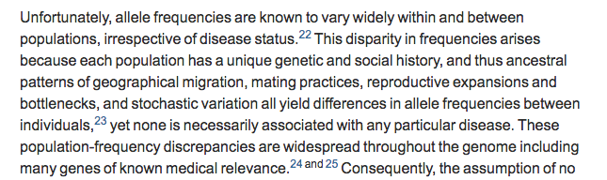
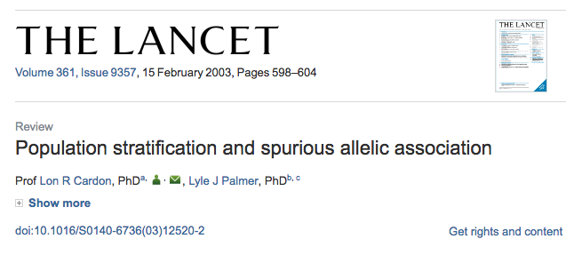
What is population stratification (pop strat)?

Slide 6
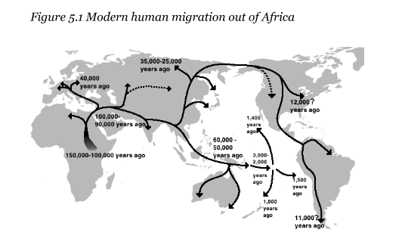
Why does it exist?

Slide 7
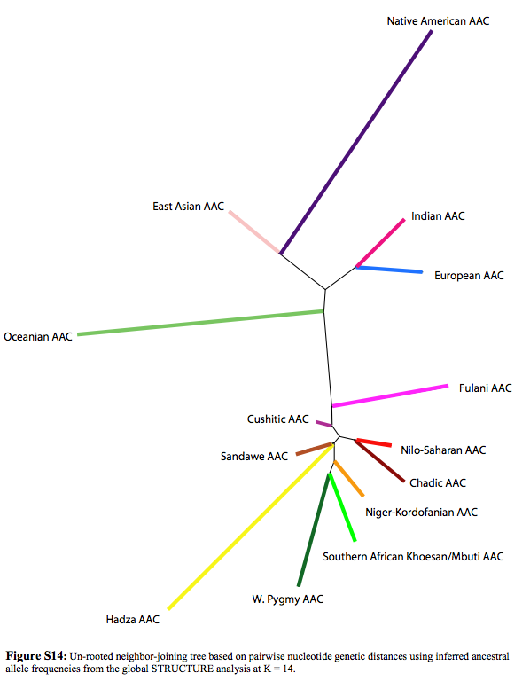
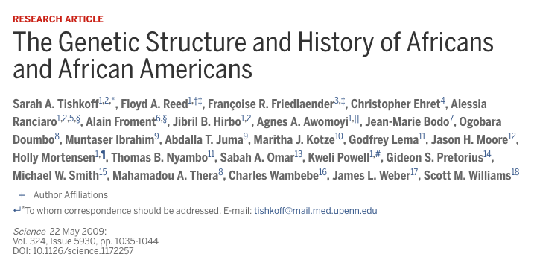

Slide 8
How does it come about
Selection: Change in allele frequency due to survival and reproductive advantages associated with a phenotype.
Drift: Change in allele frequency due to random sampling.
Hard to distinguish between the two.

Slide 9
Technically relevant details
Linkage
Haplotype
Tag SNPs

Slide 10
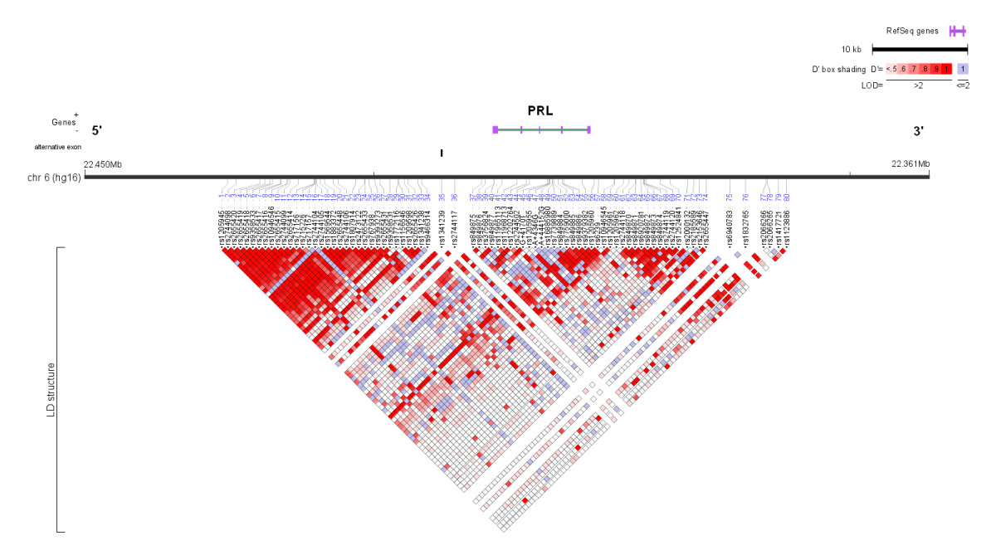
Linkage map
Tag SNPs
Linkage patterns vary across population.
Tag SNP in one group may not tag same gene in different population.

Slide 11
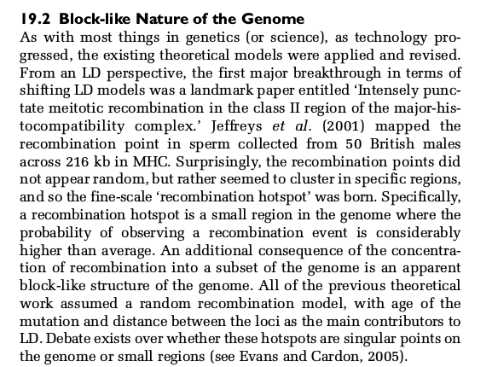
Why do we see this?

Slide 12
Haplotypes
A haplotype is a group of genes or alleles inherited together from a parent

Slide 13
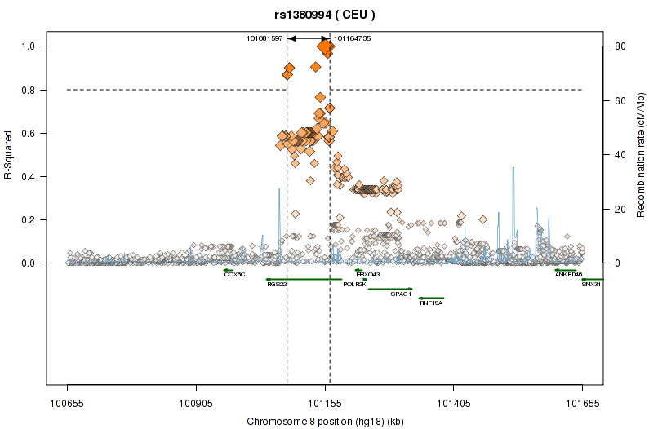
Tag SNPs

Slide 14
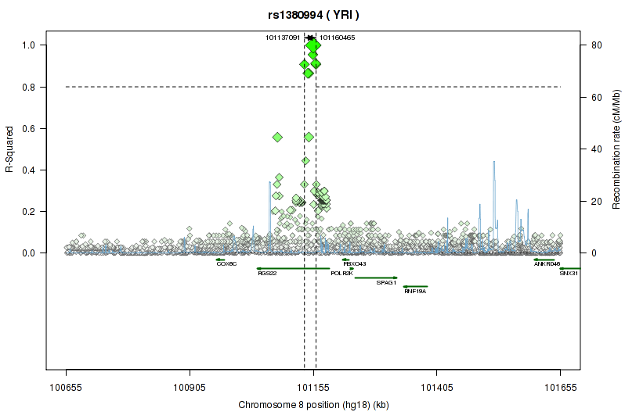
Tag SNPs

Slide 15
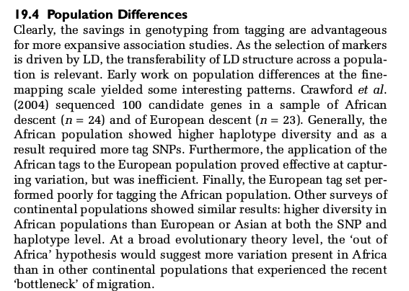
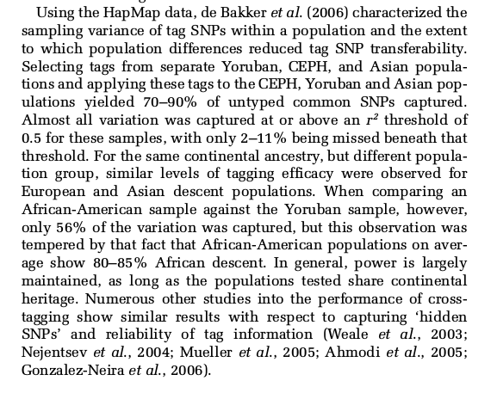
Tag SNPs and populations

Slide 16
Emphasizing the problem of getting things wrong

Slide 17
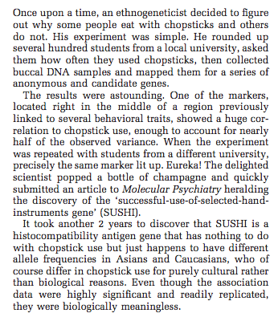
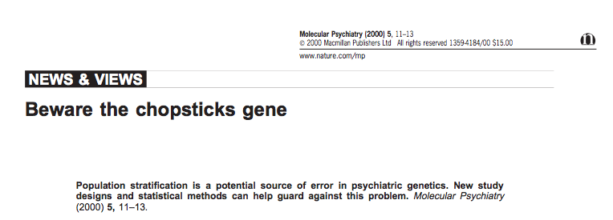
Chopsticks gene

Slide 18
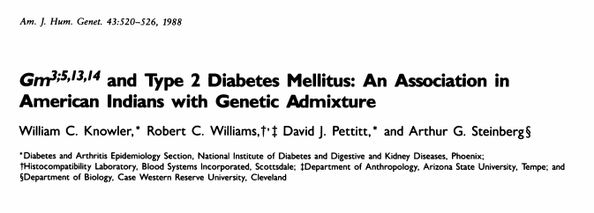
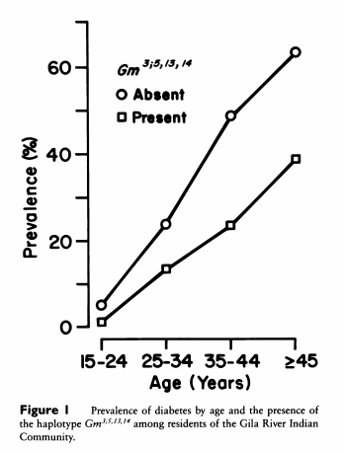
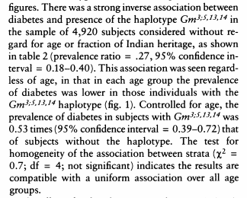
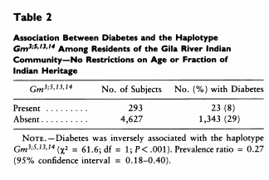
Classic example

Slide 19
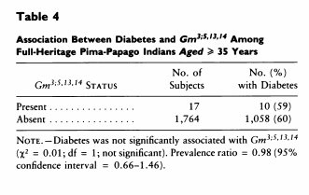
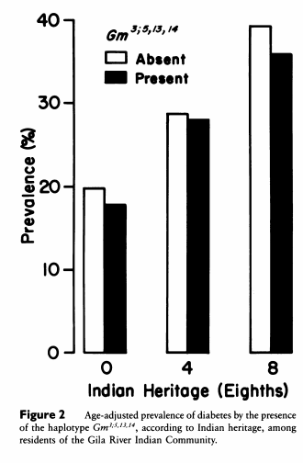
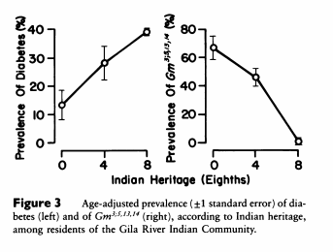
But association not present in homogenous sample (table 4) and is collinear with ancestral heritage.

Slide 20
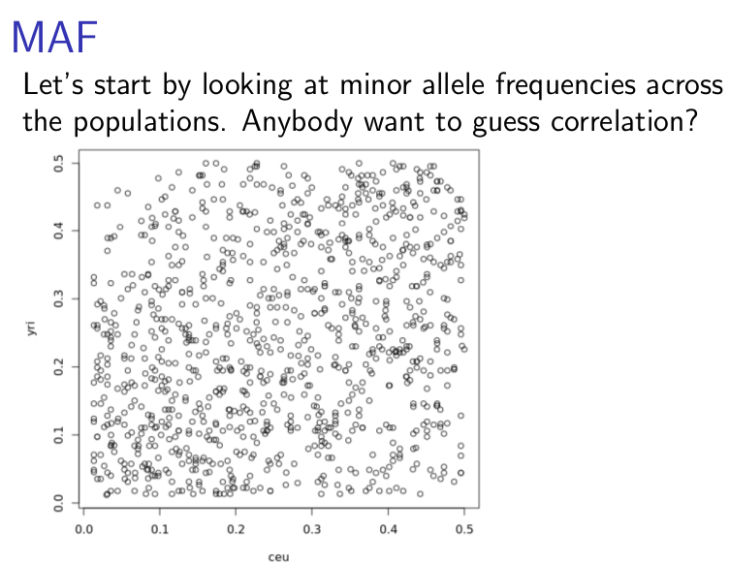
With genome-wide data, problem appears in minor allele frequencies

Slide 21
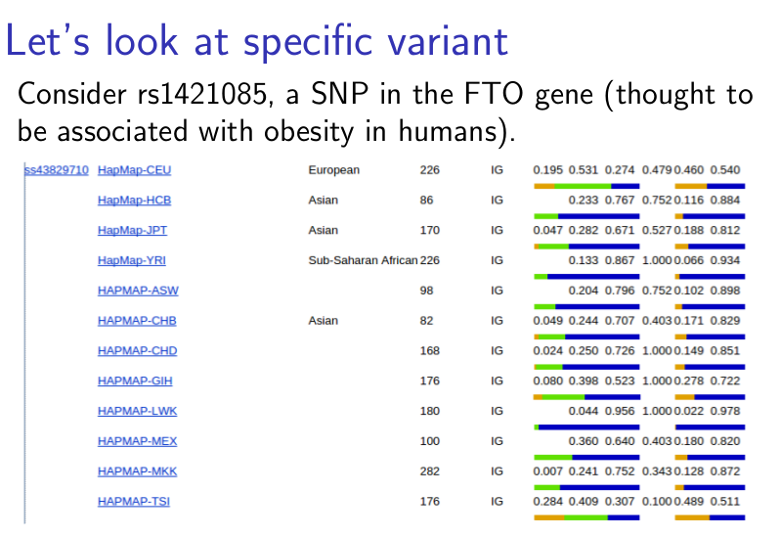

Slide 22
What to do about it
We’re going to talk about some analytical approaches that might be useful in working with heterogeneous groups.

Slide 23
PCs
[explain generic idea]

Slide 24
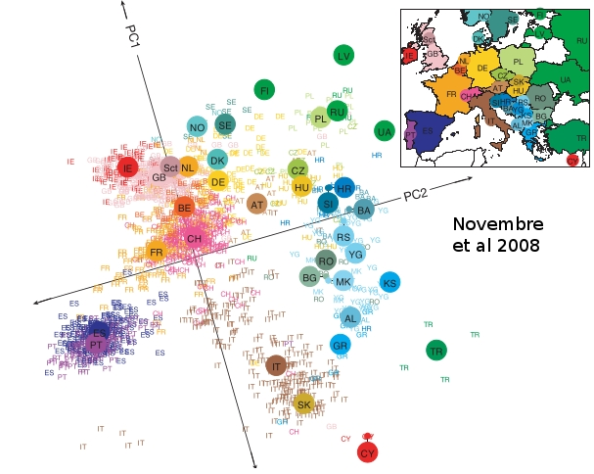

Slide 25
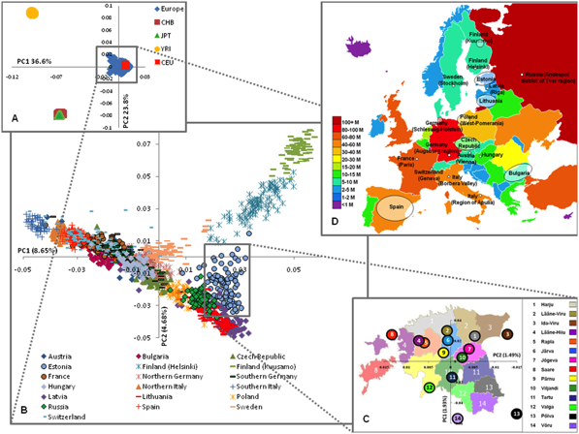
Nelis et al., 2009

Slide 26
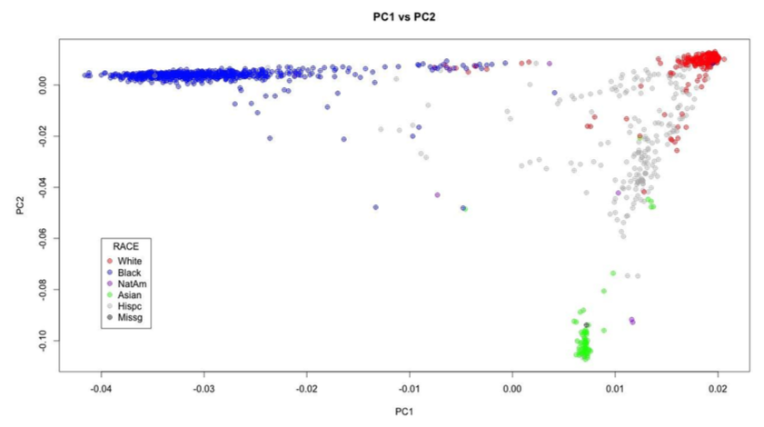
Principal Components by race
McQueen et al., 2014

Slide 27
Paper on mexico
http://www.ncbi.nlm.nih.gov/pubmed?term=24926019[uid]

Slide 28
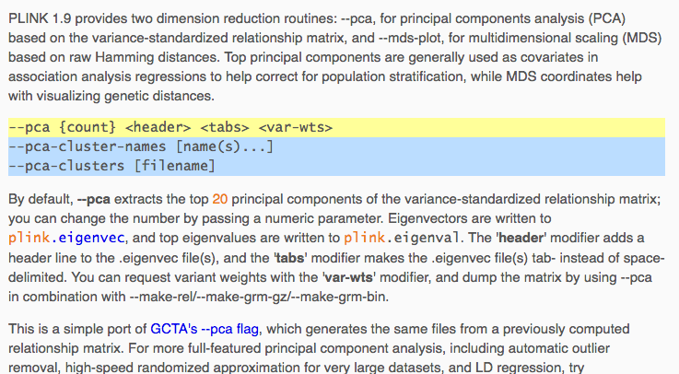
PCs

Slide 29
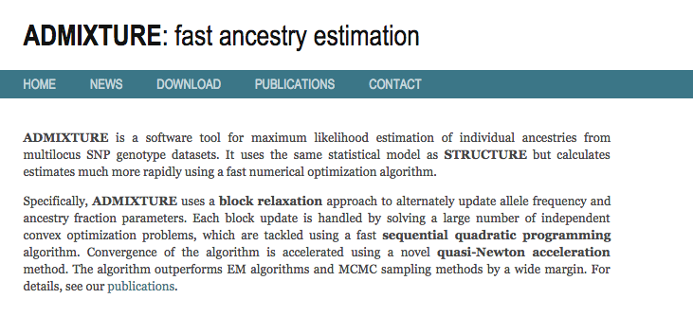
admixture
An alternative is to try to direction estimate ancestry.

Slide 30
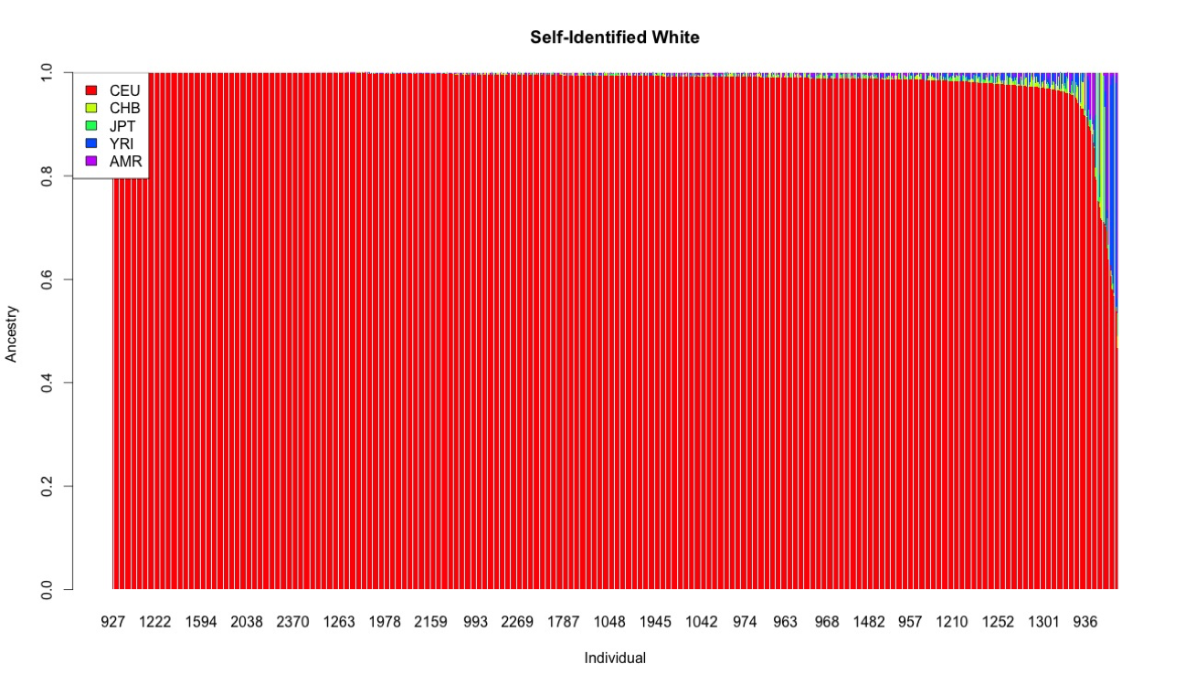
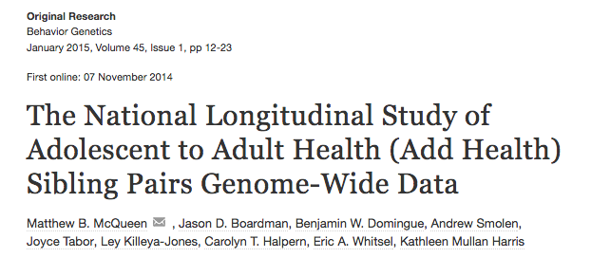
Examples from AH

Slide 31
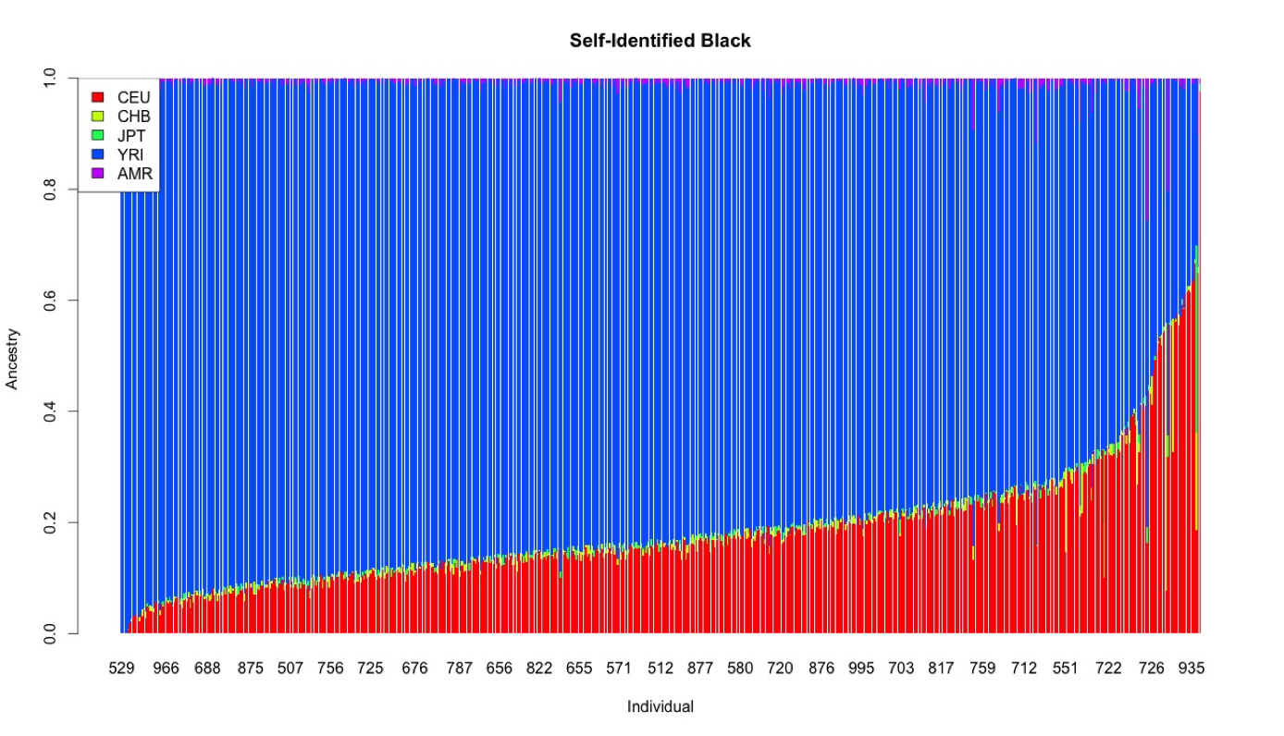
Examples from AH

Slide 32
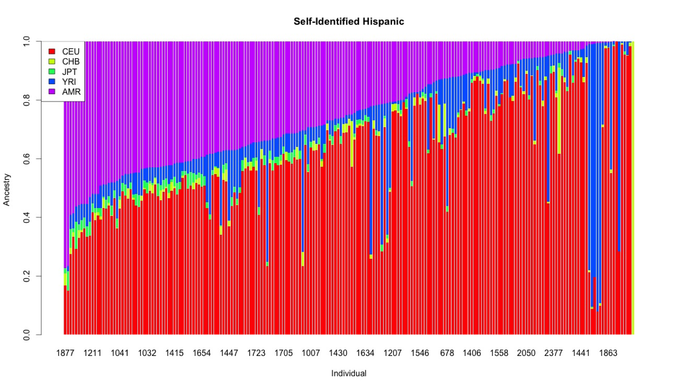
Examples from AH

Slide 33
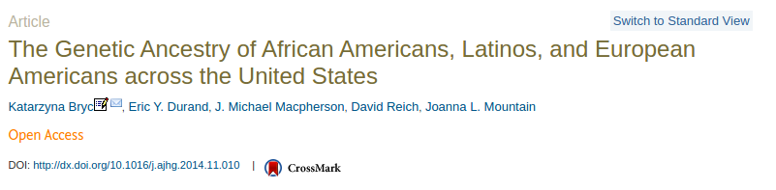
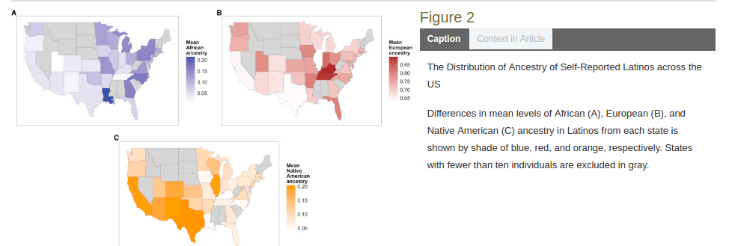

Slide 34
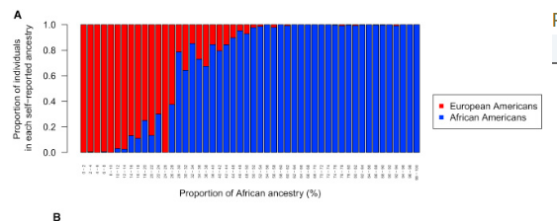
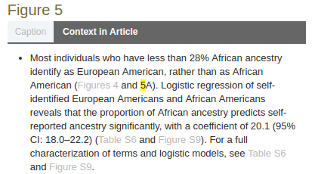

Slide 35
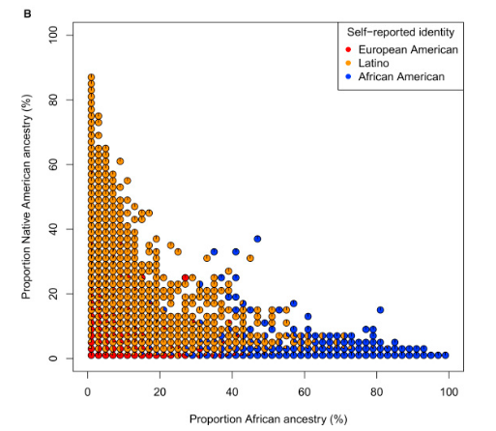
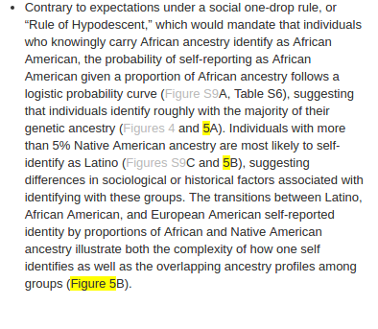

Slide 36
AIMs

Slide 37
Implications for social science
Clades [the work of troy duster?]

Slide 38
Research Focus #2
Based on your literature search yesterday and the data you noted, please start to outline a specific research question. Rough is very ok at this point!
Do a second literature search focusing in on the particular topic you are curious about.
Please note any commonly occurring names in the literature!

